Slide 1
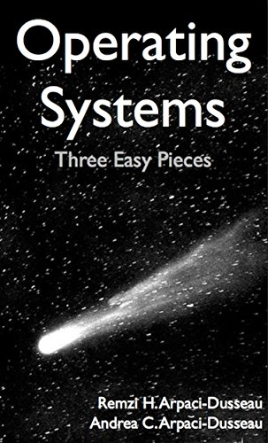
Computer Operating Systems BLG 312E
Prof. Dr. Kemal Bıçakcı

Slide 2
Evaluation Criteria and Office Hours
(Approx.) 5 Quizzes – Overall 10% (no makeup)
(Approx.) 3 Homeworks – Overall 20%
Midterm – 30%
Final Exam – 40%
Office Hours: Tuesdays and Wednesdays 12:30-13:20
Tentative Schedule and Other Info will be available at Ninova.

Slide 3
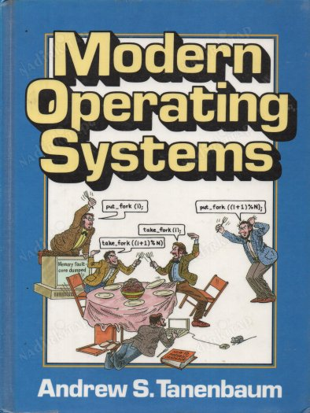
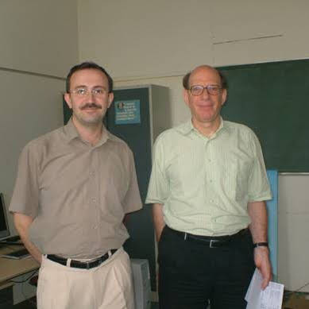

Slide 4
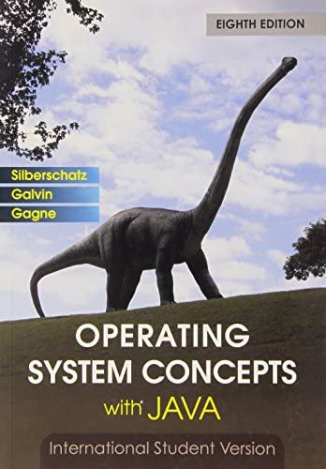

Slide 6
Virtualization
Concurrency
Persistency

Slide 7
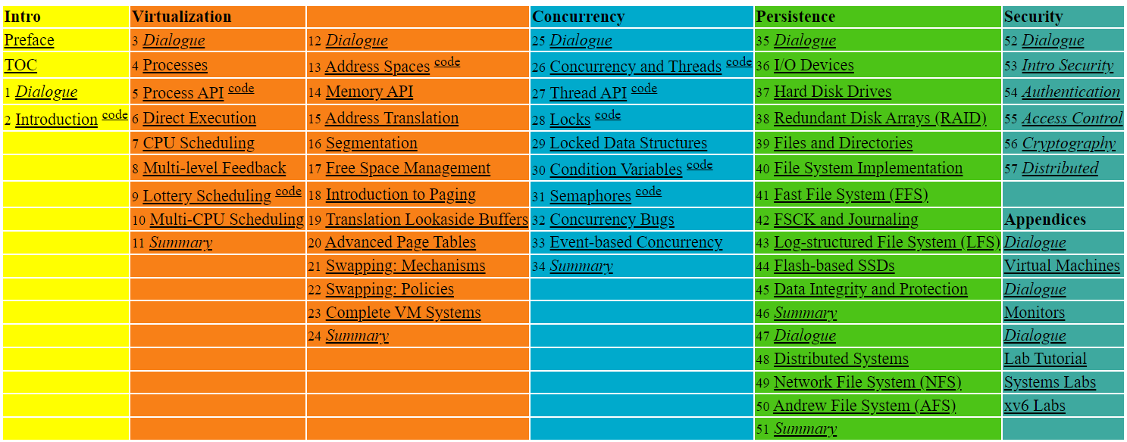

Slide 8
Introduction to Operating Systems
What happens once a computer program starts running?
A running program does only one job. What is this job?

Slide 9
What a happens when a program runs?
A running program executes instructions.
The processor fetches an instruction from memory.
Decode: Figure out which instruction this is
Execute: i.e., add two numbers, access memory, check a condition, jump to function, and so forth.
The processor moves on to the next instruction and so on.
Von Neuman architecture (Data and Program are stored on the same memory)

Slide 10
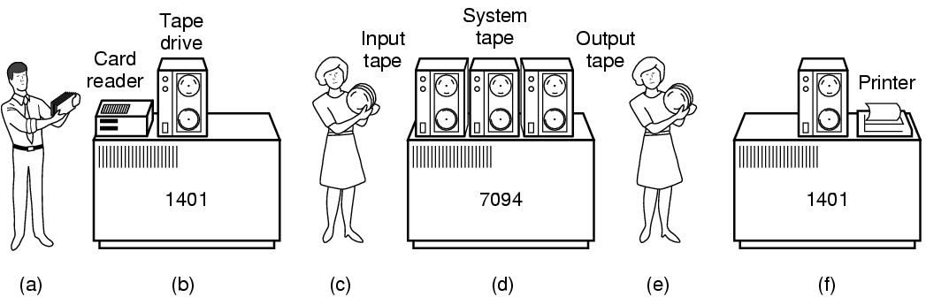
Batch Systems

Slide 11
Operating System (OS)
Responsible for
Making it easy to run programs
Allowing programs to share memory
Enabling programs to interact with devices
OS is in charge of making sure the system operates correctly and efficiently.
OS = Resource Manager + Extended (Virtual) Machine

Slide 12
Operating System =
Resource Manager + Extended (Virtual) Machine

Slide 13
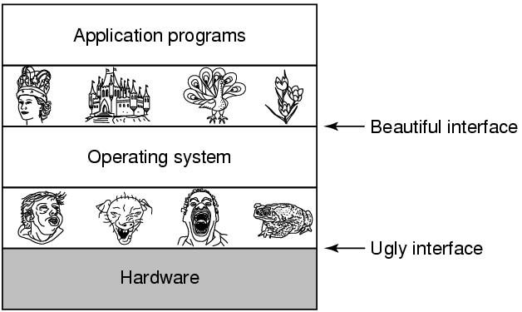
Extended Machine

Slide 14
Virtualization
The OS takes a physical resource and transforms it into a virtual form of itself.
Physical resource: Processor, Memory, Disk …
The virtual form is more general, powerful and easy-to-use.
Sometimes, we refer to the OS as a virtual machine.
(A different usage!: The virtual machine term is also used for software systems (e.g.: VMware, Virtual Box) that emulate a physical computer to run multiple operating systems on a computer.)

Slide 15
System call
System call allows user to tell the OS what to do.
The OS provides some interface (APIs, standard library).
A typical OS exports a few hundred system calls.
Run programs
Access memory
Access devices

Slide 16
The OS is a resource manager.
The OS manage resources such as CPU, memory and disk.
The OS allows
Many programs to run → Sharing the CPU
Many programs to concurrently access their own instructions and data → Sharing memory
Many programs to access devices → Sharing disks

Slide 17
Virtualizing the CPU
The system has a very large number of virtual CPUs.
Turning a single CPU into a seemingly infinite number of CPUs.
Allowing many programs to seemingly run at once → Virtualizing the CPU
(Note: A computer can be assumed to have only one processor unless otherwise noted.)

Slide 18
Virtualizing the CPU (Cont.)
1 #include <stdio.h>
2 #include <stdlib.h>
3 #include <sys/time.h>
4 #include <assert.h>
5 #include "common.h"
6
7 int
8 main(int argc, char *argv[])
9 {
10 if (argc != 2) {
11 fprintf(stderr, "usage: cpu <string>\n");
12 exit(1);
13 }
14 char *str = argv[1];
15 while (1) {
16 Spin(1); // Repeatedly checks the time and returns once it has run for a second
17 printf("%s\n", str);
18 }
19 return 0;
20 }
Simple Example(cpu.c): Code That Loops and Prints

Slide 19
Virtualizing the CPU (Cont.)
Execution result 1.
prompt> gcc -o cpu cpu.c -Wall
prompt> ./cpu "A"
A
A
A
ˆC
prompt>
Run forever; Only by pressing “Control-c” can we halt the program

Slide 20
Virtualizing the CPU (Cont.)
Execution result 2.
prompt> ./cpu A & ; ./cpu B & ; ./cpu C & ; ./cpu D &
[1] 7353
[2] 7354
[3] 7355
[4] 7356
A
B
D
C
A
B
D
C
A
C
B
D
...
Even though we have only one processor, all four of programs seem to be running at the same time!

Slide 21
Mechanism and Policy
Running programs at the same time raises many questions.
Example: Which of the programs should we choose to run?
These questions are answered by the policy (What?) implemented by the OS.
On the other hand, OS achieves this capability by performing mechanisms (How?).
The separation of mechanism and policy is a general design principle in computer science.

Slide 22
Virtualizing Memory
The physical memory is an array of bytes.
A program keeps all of its data structures in memory.
Read memory (load):
Specify an address to be able to access the data
Write memory (store):
Specify the data to be written to the given address
It should be noted that the instructions of the program are also kept in memory. Therefore, the memory is accessed many times while the program is running.

Slide 23
Virtualizing Memory (Cont.)
A program that accesses memory (mem.c)
1 #include <unistd.h>
2 #include <stdio.h>
3 #include <stdlib.h>
4 #include "common.h"
5
6 int
7 main(int argc, char *argv[])
8 {
9 int *p = malloc(sizeof(int)); // a1: allocate some memory
10 assert(p != NULL);
11 printf("(%d) address of p: %08x\n",
12 getpid(), (unsigned) p); // a2: print out the address of the memmory
13 *p = 0; // a3: put zero into the first slot of the memory
14 while (1) {
15 Spin(1);
16 *p = *p + 1;
17 printf("(%d) p: %d\n", getpid(), *p); // a4
18 }
19 return 0;
20 }

Slide 24
Virtualizing Memory (Cont.)
The output of the program mem.c
The newly allocated memory is at address 00200000.
It updates the value and prints out the result.
prompt> ./mem
(2134) memory address of p: 00200000
(2134) p: 1
(2134) p: 2
(2134) p: 3
(2134) p: 4
(2134) p: 5
ˆC

Slide 25
Virtualizing Memory (Cont.)
Running mem.c multiple times
It is as if each running program has its own private memory.
Each running program has allocated memory at the same address.
Each seems to be updating the value at 00200000 independently.
prompt> ./mem &; ./mem &
[1] 24113
[2] 24114
(24113) memory address of p: 00200000
(24114) memory address of p: 00200000
(24113) p: 1
(24114) p: 1
(24114) p: 2
(24113) p: 2
(24113) p: 3
(24114) p: 3
...

Slide 26
Important Note: To observe that the same address is used, the «address-space randomization» feature must be turned off.

Slide 27
Virtualizing Memory (Cont.)
Each process accesses its own private virtual address space.
The OS maps address space onto the physical memory.
A memory reference within one running program does not affect the address space of other processes.
Physical memory is a shared resource, managed by the OS.

Slide 28
Three Easy Pieces
Virtualization
Concurrency
Persistency

Slide 29
The problem of Concurrency
While the OS is juggling many things at once (first running one process, then another, and so forth), some problems may appear.
Modern multi-threaded programs also exhibit the concurrency problem.

Slide 30
Concurrency Example
A Multi-threaded Program (thread.c)
1 #include <stdio.h>
2 #include <stdlib.h>
3 #include "common.h"
4
5 volatile int counter = 0;
6 int loops;
7
8 void *worker(void *arg) {
9 int i;
10 for (i = 0; i < loops; i++) {
11 counter++;
12 }
13 return NULL;
}
...

Slide 31
Concurrency Example (Cont.)
16 int
17 main(int argc, char *argv[])
18 {
19 if (argc != 2) {
20 fprintf(stderr, "usage: threads <value>\n");
21 exit(1);
22 }
23 loops = atoi(argv[1]);
24 pthread_t p1, p2;
25 printf("Initial value : %d\n", counter);
26
27 Pthread_create(&p1, NULL, worker, NULL);
28 Pthread_create(&p2, NULL, worker, NULL);
29 Pthread_join(p1, NULL);
30 Pthread_join(p2, NULL);
31 printf("Final value : %d\n", counter);
32 return 0;
33 }
The main program creates two threads.
Thread: a function running within the same memory space. Each thread start running in a routine called worker().
worker(): increments a counter

Slide 32
Concurrency Example (Cont.)
loops determines how many times each of the two workers will increment the shared counter in a loop.
loops: 1000.
loops: 100000.
prompt> gcc -o thread thread.c -Wall -pthread
prompt> ./thread 1000
Initial value : 0
Final value : 2000
prompt> ./thread 100000
Initial value : 0
Final value : 143012 // huh??
prompt> ./thread 100000
Initial value : 0
Final value : 137298 // what the??

Slide 33
Why is this happening?
Increment a shared counter → take three instructions.
Load the value of the counter from memory into register.
Increment it
Store it back into memory
These three instructions do not execute atomically. → Problem of concurrency happen.

Slide 34
Three Easy Pieces
Virtualization
Concurrency
Persistency

Slide 35
Persistence
Devices such as DRAM store values in a volatile.
Hardware and software are needed to store data persistently.
Hardware: I/O device such as a hard drive, solid-state drives(SSDs)
Software:
File system manages the disk.
File system is responsible for storing any files the user creates.

Slide 36
Persistence (Cont.)
Create a file (/tmp/file) that contains the string “hello world”
1 #include <stdio.h>
2 #include <unistd.h>
3 #include <assert.h>
4 #include <fcntl.h>
5 #include <sys/types.h>
6
7 int
8 main(int argc, char *argv[])
9 {
10 int fd = open("/tmp/file", O_WRONLY | O_CREAT | O_TRUNC, S_IRWXU);
11 assert(fd > -1);
12 int rc = write(fd, "hello world\n", 13);
13 assert(rc == 13);
14 close(fd);
15 return 0;
16 }
open(), write(), and close() system calls are routed to the part of OS called the file system, which handles the requests

Slide 37
Persistence – Writing to Disk
Let’s just talk a little bit, but first you have to promise to close your eyes; yes so unpleasant issues:
Find where the data is on the disk
Save this state in the various structures of the file system.
Send the appropriate I/O requests to the storage device.
…
As anyone who writes a device driver knows, it requires a complex and elaborate process. Lucky for us, there is an Operating System that does all this unpleasant work ☺

Slide 38
Design Goals
Build up abstraction
Make the system convenient and easy to use.
Provide high performance
Minimize the overhead of the OS.
OS must strive to provide virtualization without excessive overhead.
Protection between applications
Isolation: Bad behavior of one does not harm other and the OS itself.

Slide 39
Design Goals (Cont.)
High degree of reliability
The OS must also run non-stop.
Other issues
Energy-efficiency
Security
Mobility

Slide 40
OS History
Will talk about it in the next lecture.
Tanenbaum – Torvalds Debate:
https://www.oreilly.com/openbook/opensources/book/appa.html

Slide 41
Youtube Channel for Turkish Version of Lectures
https://www.youtube.com/@kemalbicakci

